Slide 1
Emancipation
The American Battlefield Trust

Slide 2
Inquiry Question:
Why was the Emancipation Proclamation issued in September 1862?
Notes:
Ask students to create a hypothesis of the answer to this question. Have students either discuss in groups their ideas or as a class. Ask students how they produced those hypothesis.

Slide 3
Emancipation:
the fact or process of being set free from legal, social, or political restrictions; liberation

Slide 4
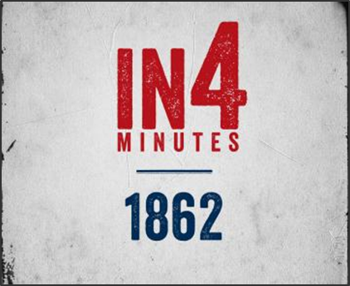

The War So Far
Activity
Watch 1862 In4 Video until 3 min 34 seconds.
Notes:
Discussion Questions:
How did the Union feel as the summer of 1862 came to an end?
Robert E. Lee decided to do what exactly as a result of his victories in Virginia?
Why might public approval of a war be so important?

Slide 5
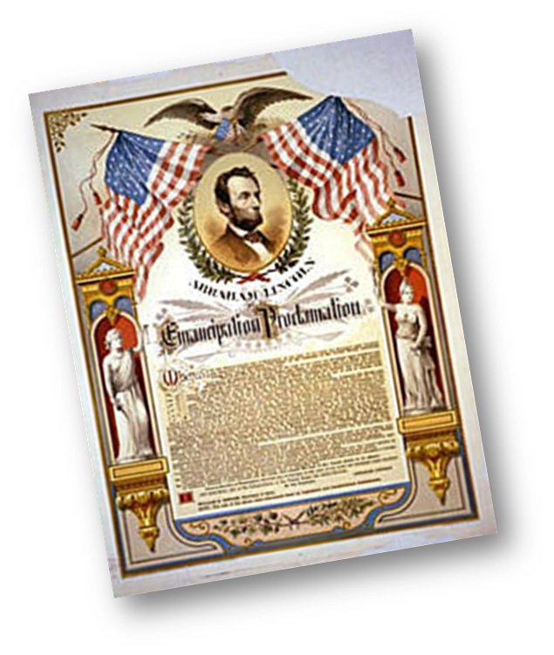
The First Discussion
“It may be viewed as the last measure of an exhausted government, a cry for help…. Postpone its issue, until you can give it to the country supported by military success, instead of issuing it, as would be the case now, upon the greatest disasters of the war!”
– Secretary of State, William Seward.
On July 22, 1862 Lincoln presents the Preliminary Emancipation Proclamation to his cabinet.
Secretary of State, William Seward suggests that a Union victory should be achieved before issuing the proclamation.
Notes:
Direct students to look at their timeline and see where the war is militarily in mid-July. Discuss with students why Seward would have this opinion
Sewards quote comes from Six Months in the White House by Francis Bicknell Carpenter, Hurd and Houghton, 1872. The “greatest disasters of the war” is in reference to McClellan’s failed Peninsula campaign.

Slide 6
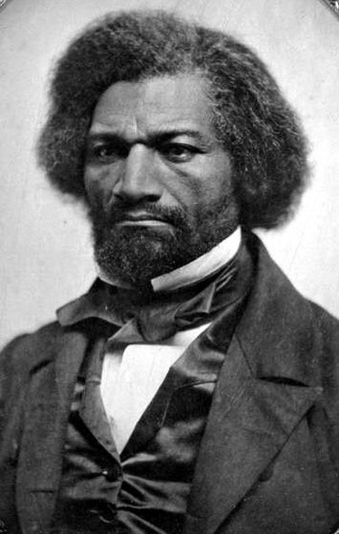
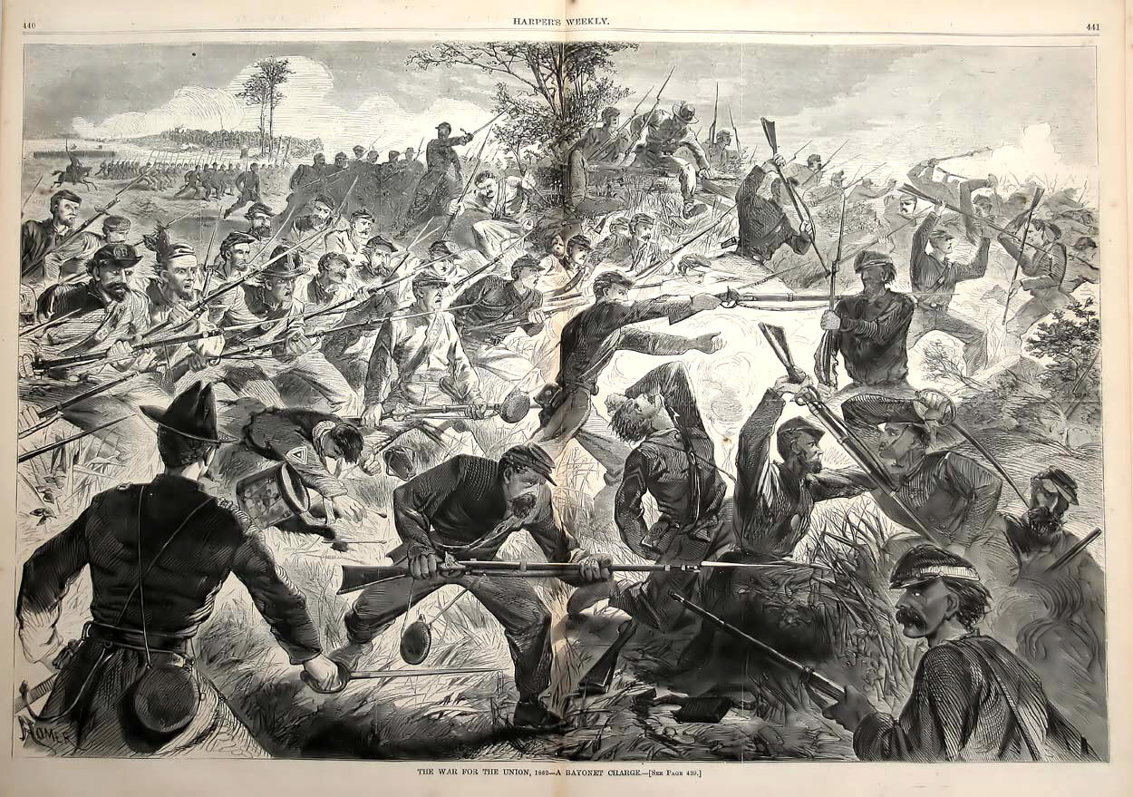
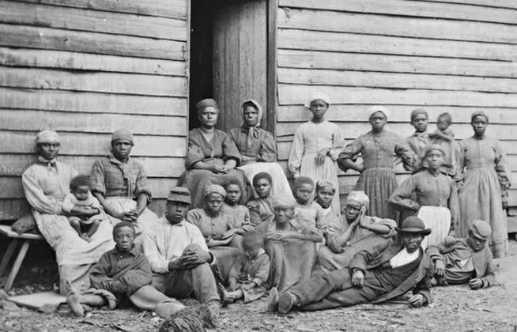

Pressure Builds
By the summer of 1862:
  Lincoln is faced with increasing pressure from abolitionists seeking emancipation as part of the war effort.
  The risk of foreign involvement grows (Great Britain and France could recognize and help the Confederacy).
  Large numbers of slaves are leaving their owners and entering Union army camps as refugees.
  Loss of battles leads to less war support from US citizens.

Slide 7
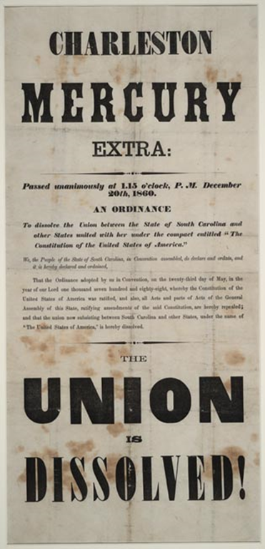
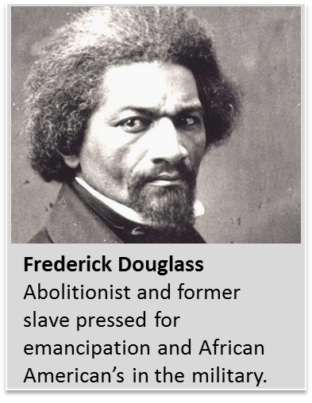
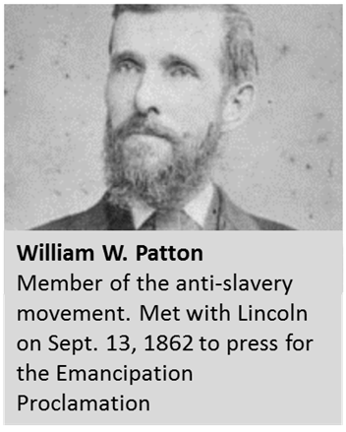
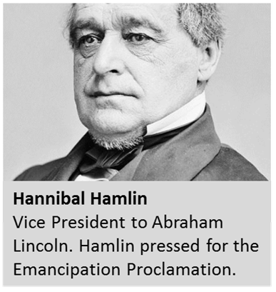
Abolitionists
What is the war about?
Preserving the Union or Freeing the Slaves?
Notes:
Discuss why do you think abolitionists were pushing for Emancipation during the Civil War?

Slide 8

Abolitionists
Activity
Read the following Documents:
Our War and Our Want
The War and How to End it
President Lincoln and the Chicago Memorial on Emancipation
Discuss:
In what year were all three of the documents created?
Compare the three authors who wrote these documents. Where they all Northerners? African American? Religious leaders? Women?

Slide 9

Foreign Affairs
Activity
Read the following:
Article, “Abraham Lincoln: Foreign Affairs”
Discuss:
For the Confederacy, what would have been the benefit of foreign nations recognizing it as a separate nation?
Why might the Union not want involvement from foreign nations?
What might keep foreign nations from getting involved with the war?

Slide 10
Black self-Agency
Activity
Read the following Documents and Secondary Source
African American Refugees Coming into the Union Lines
Black Ohioan to the Secretary of War
Betty Guwn Interview
I Freed Myself
Discuss:
Do you think Betty and her husband’s experience was unique?
How could these activities effect Lincoln and the nation?
Notes:
Here it is important to discuss the self-agency of the slaves, former slaves, and black population.

Slide 11

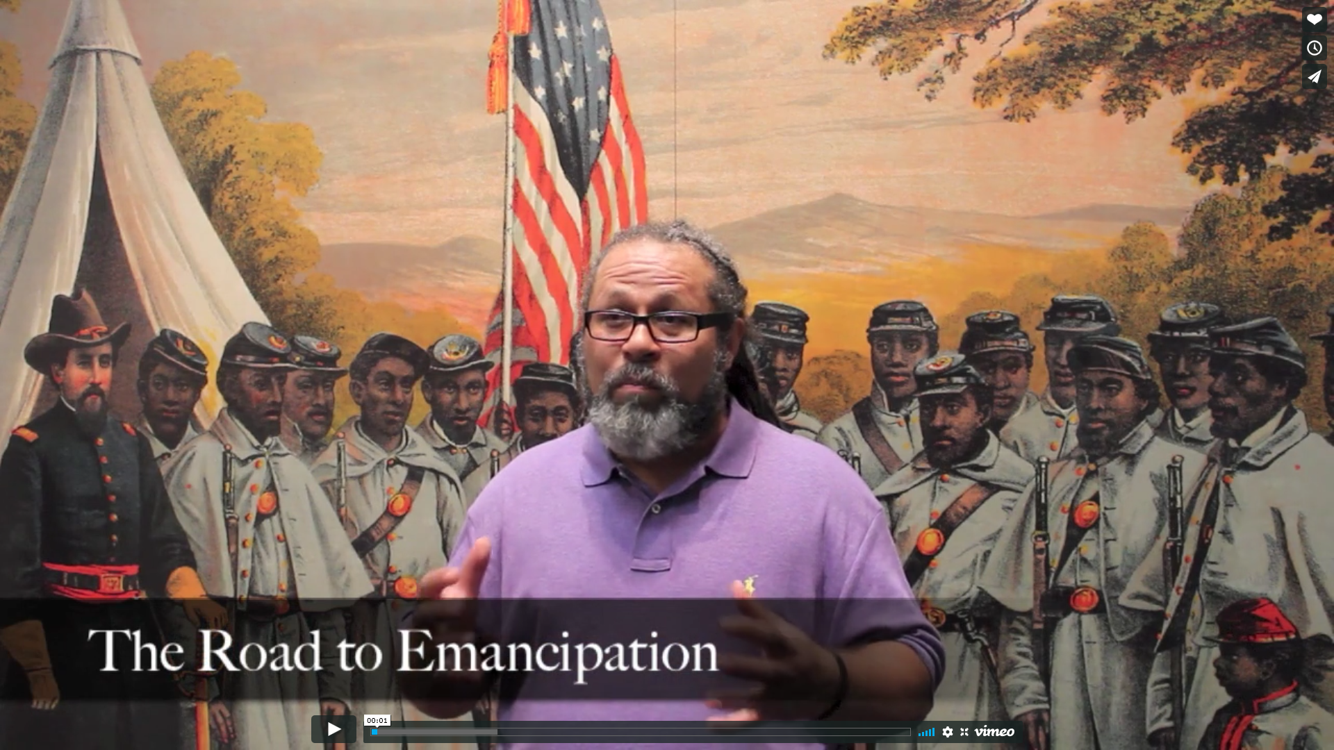
Legislation
Activity
Watch The Road to Emancipation video.
Read the legislation:
Immediate Compensated Emancipation Act
Law Enacting Emancipation in the Federal Territories
The Second Confiscation Act

Slide 12
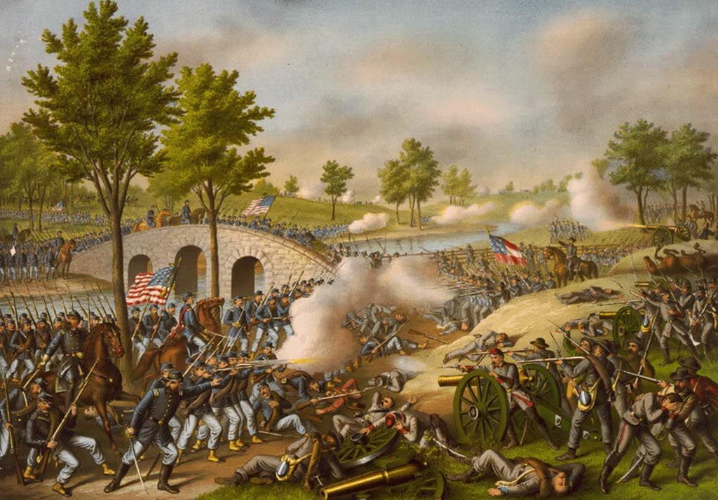
Antietam
September 17, 1862
Activity
As a group read the Battle of Antietam Summary.

Slide 13
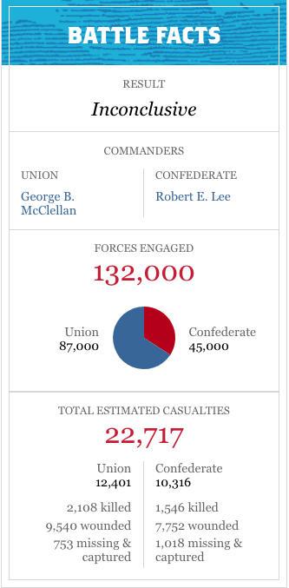
Antietam
Result: The Confederate Army retreats from Maryland, back into Virginia. This allows the Union to claim a “victory”
Abraham Lincoln now has the “victory” he desired to issue the Emancipation Proclamation

Slide 14
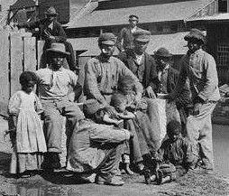
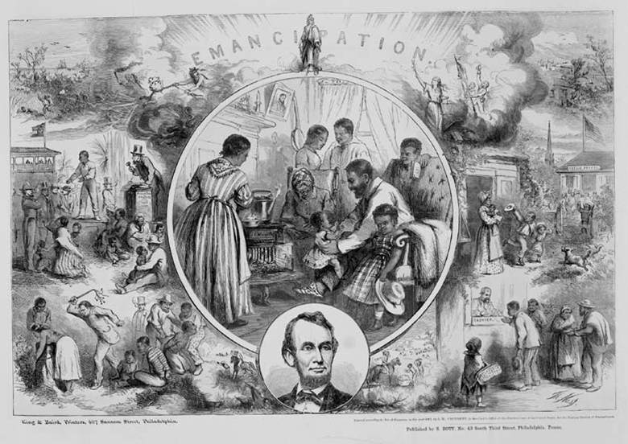
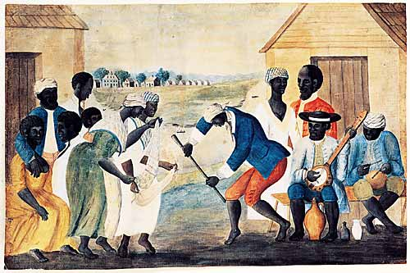
Emancipation
Activity
Read through the Emancipation Proclamation
Notes:
Segment of the Emancipation Proclamation can be found on the next page

Slide 15
Emancipation Proclamation
“That on the first day of January, in the year of our Lord one thousand eight hundred and sixty-three, all persons held as slaves within any State or designated part of a State, the people whereof shall then be in rebellion against the United States, shall be then, thenceforward, and forever free; and the Executive Government of the United States, including the military and naval authority thereof, will recognize and maintain the freedom of such persons, and will do no act or acts to repress such persons, or any of them, in any efforts they may make for their actual freedom.”
- January 1, 1863; National Archives; Emancipation Proclamation

Slide 16
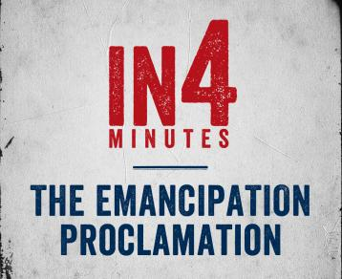
Emancipation
Activity
Watch the Emancipation Proclamation In4 video.

Slide 17
Inquiry Question:
Why was the Emancipation Proclamation issued in September 1862?
Notes:
Discuss with the students on whether their hypothesis were correct or not. Discuss what the students learned from their primary and secondary sources.

